Slide 1

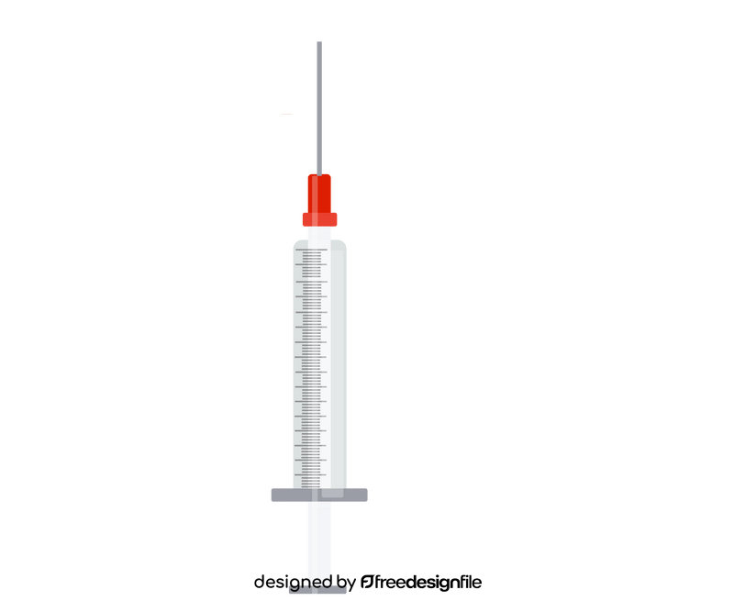

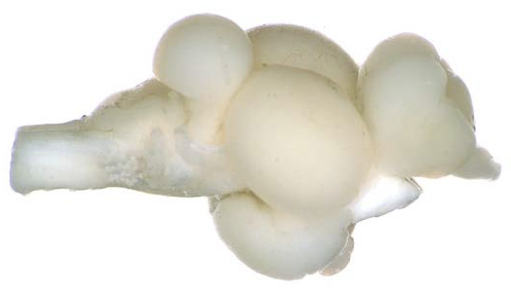
a
♂
♂
♂
D
6 Months
Pairing
n = 10 pairs
Parental Care Assay
D
♂
Dissect out POA for snMultiome
Gonadal Histology
Serum 11KT Analysis
b
c
d
e
f
g

